Slide 1
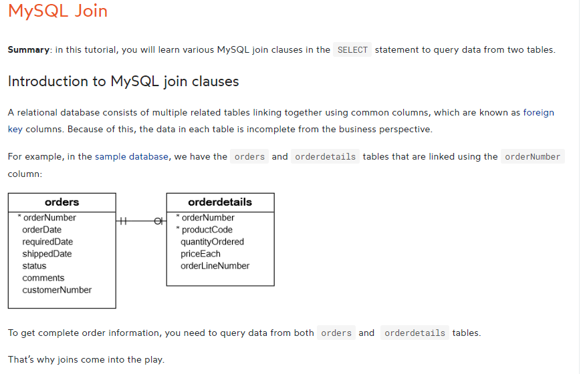

Slide 2
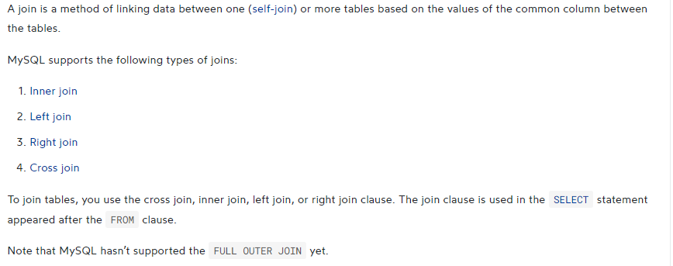
CREATE TABLE members (
member_id INT AUTO_INCREMENT,
name VARCHAR(100),
PRIMARY KEY (member_id)
);
CREATE TABLE committees (
committee_id INT AUTO_INCREMENT,
name VARCHAR(100),
PRIMARY KEY (committee_id)
);
INSERT INTO members(name)
VALUES('John'),('Jane'),('Mary'),('David'),('Amelia');
INSERT INTO committees(name)
VALUES('John'),('Mary'),('Amelia'),('Joe');

Slide 3
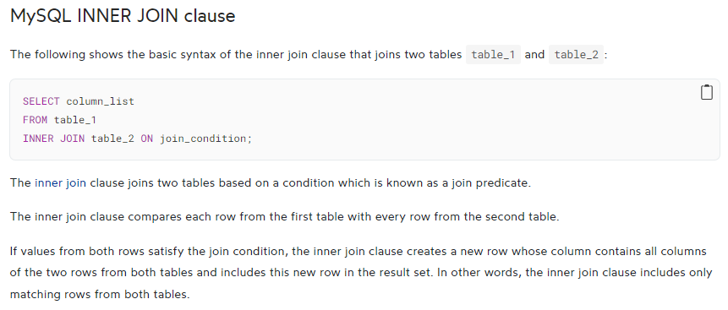
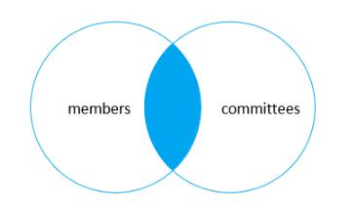
SELECT
m.member_id, m.name AS member, c.committee_id,
c.name AS committee
FROM
members m
INNER JOIN committees c ON c.name = m.name;

Slide 4
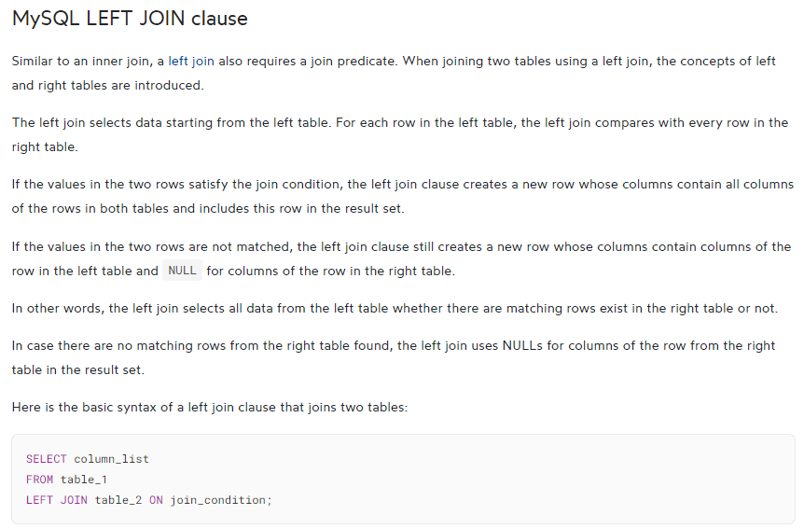

Slide 5
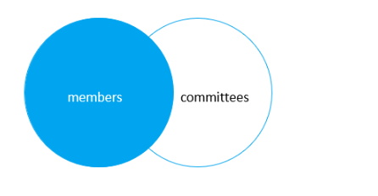
SELECT
m.member_id,
m.name AS member,
c.committee_id,
c.name AS committee
FROM
members m
LEFT JOIN committees c USING(name);

Slide 6
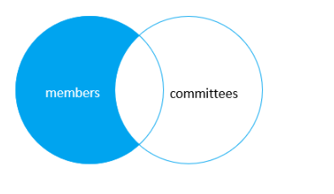
SELECT
m.member_id,
m.name AS member,
c.committee_id,
c.name AS committee
FROM
members m
LEFT JOIN committees c USING(name)
WHERE c.committee_id IS NULL;

Slide 7
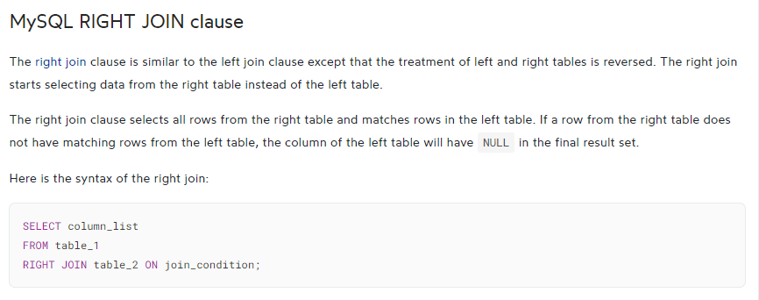
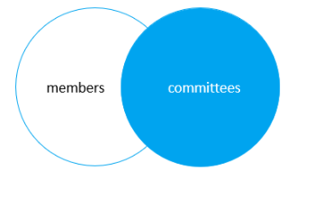
SELECT
m.member_id, m.name AS member, c.committee_id,
c.name AS committee
FROM
members m
RIGHT JOIN committees c on c.name = m.name;

Slide 8

SELECT
m.member_id,
m.name AS member,
c.committee_id,
c.name AS committee
FROM
members m
RIGHT JOIN committees c USING(name)
WHERE m.member_id IS NULL;

Slide 9
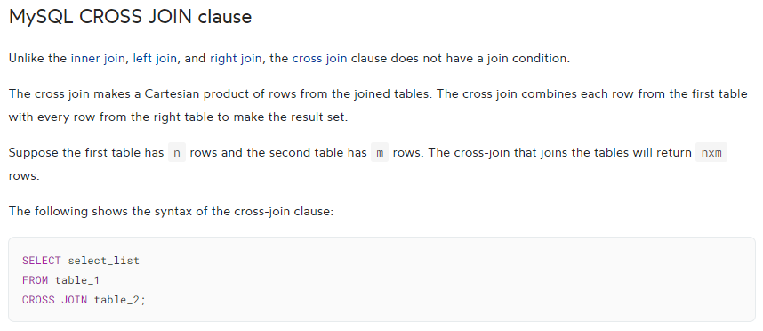
SELECT
m.member_id, m.name AS member, c.committee_id,
c.name AS committee
FROM
members m
CROSS JOIN committees c;

Slide 10
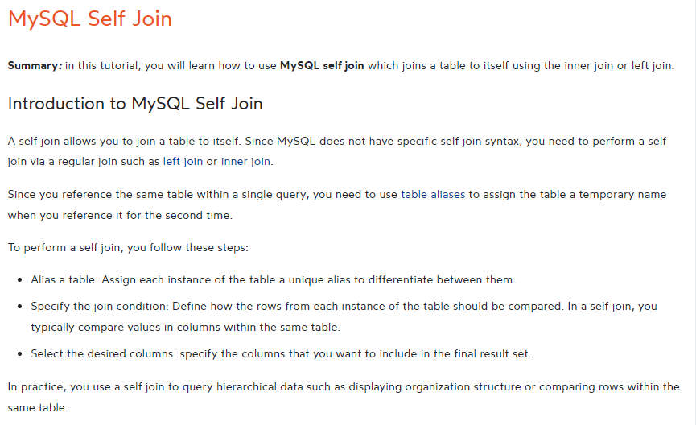

Slide 11
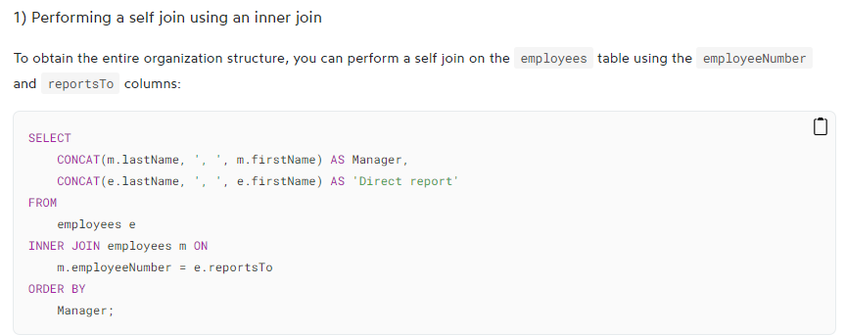

Slide 12
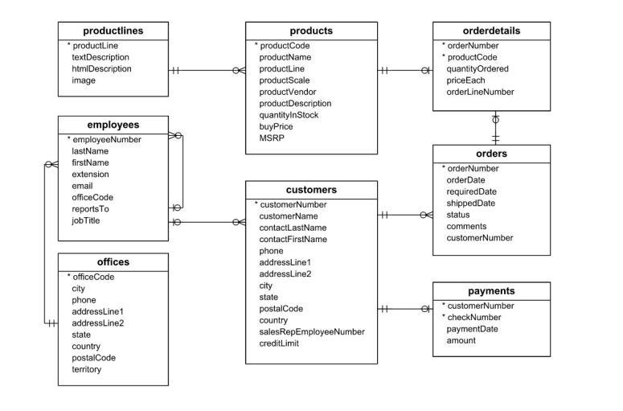
Dataset Link: https://www.mysqltutorial.org/wp-content/uploads/2023/10/mysqlsampledatabase.zip

Slide 13
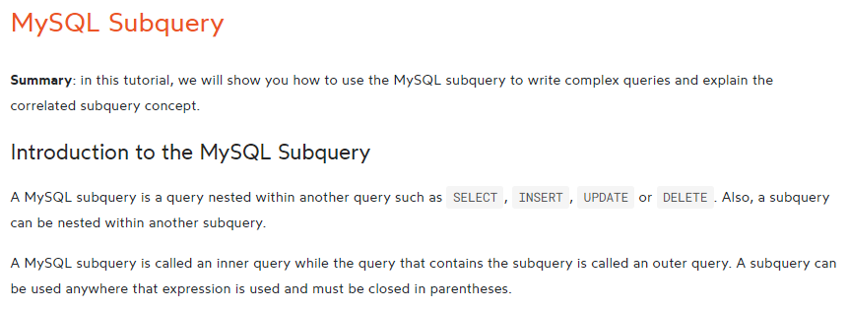

Slide 14
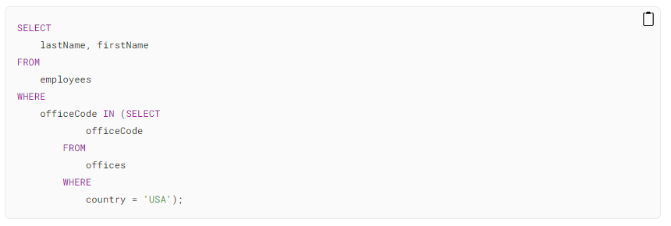
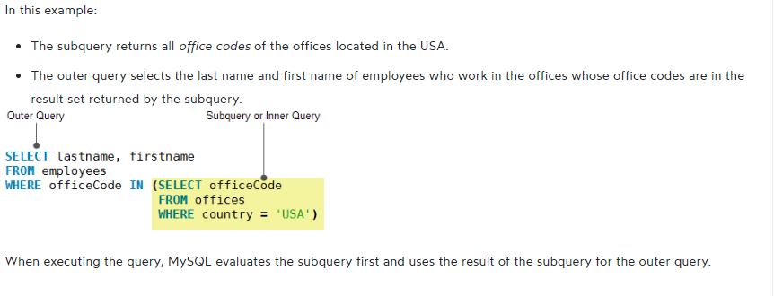

Slide 15
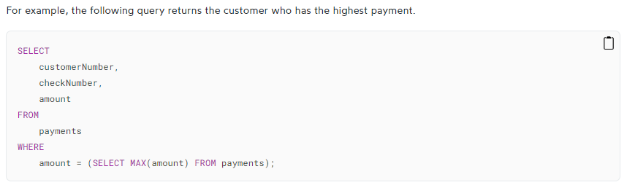
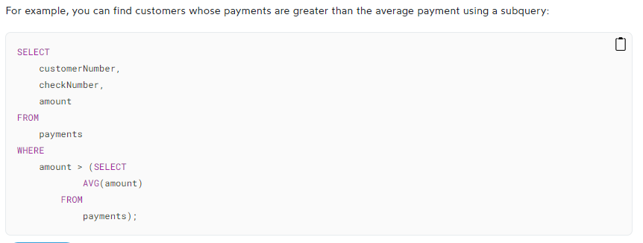

Slide 16
